Slide 1





MGT 256 Group 3
Analysis of Movie Dataset
to Know insights of the movie world
Professor: Adem Orsdemir
Team Members:
Adam Portillo Chuyang Liu
Jeewan Singh Minhua Jiang
Suyash Saxena

Slide 2
CONTENTS
01
Research Problems
02
Our Data
03
Main Variables We Choose
04
Clean Missing Variables
05
Data Visualization

Slide 3



How do you define
a successful movie ？
「La La Land」-2016
「Hangover」-2009
「The Irishman」-2019

Slide 4

Research Problems
Movie Stars ？
Film Director ？
Financial Value ？
Audience rating ？

Slide 5
Research Problem
What variables are fundamental to a film's ability to earn high revenues?
The relationship between the face value of the actor/director and the story of the film.
Can we predict the rating of an upcoming movie based on specific variable values?

Slide 6
Our Data

Slide 7
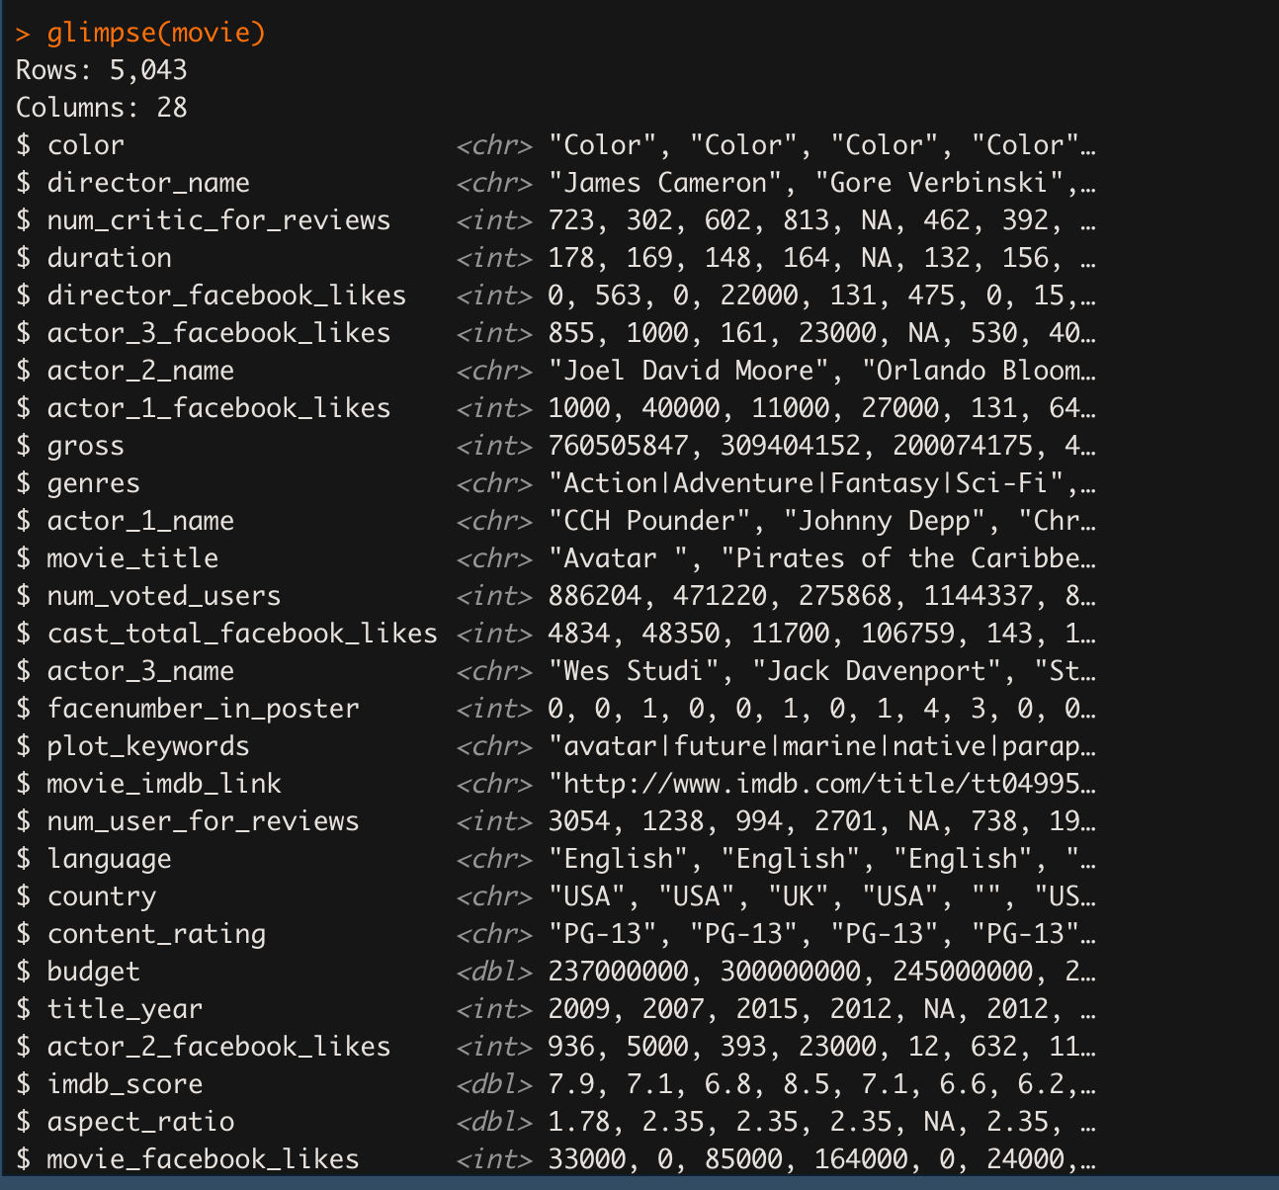
Our Data from https://www.kaggle.com/datasets/carolzhangdc/imdb-5000-movie-dataset
Data Overview: explore the data we have
5043 movie observations
28 variables
across 100 years
66 countries
outcome

Slide 8

Main Variables We Choose

Slide 9
Main Variables
IMDB score | the score of the movie on IMDB.com
Directors | the names of the directors
Critic Reviews | numbers of Critic reviews
Duration | the time of the movie
Director Facebook likes | number of likes of the director on his/her Facebook Page
Actor Facebook like: | number of likes of the Actor on his/her Facebook Page
Genres | the form, style or category of the movie
Gross Revenue | the total revenue of the movie
Budget | the budget of the movie
Plot Keywords | the type of the movie, description keywords

Slide 10
Clean Missing Variables

Slide 11
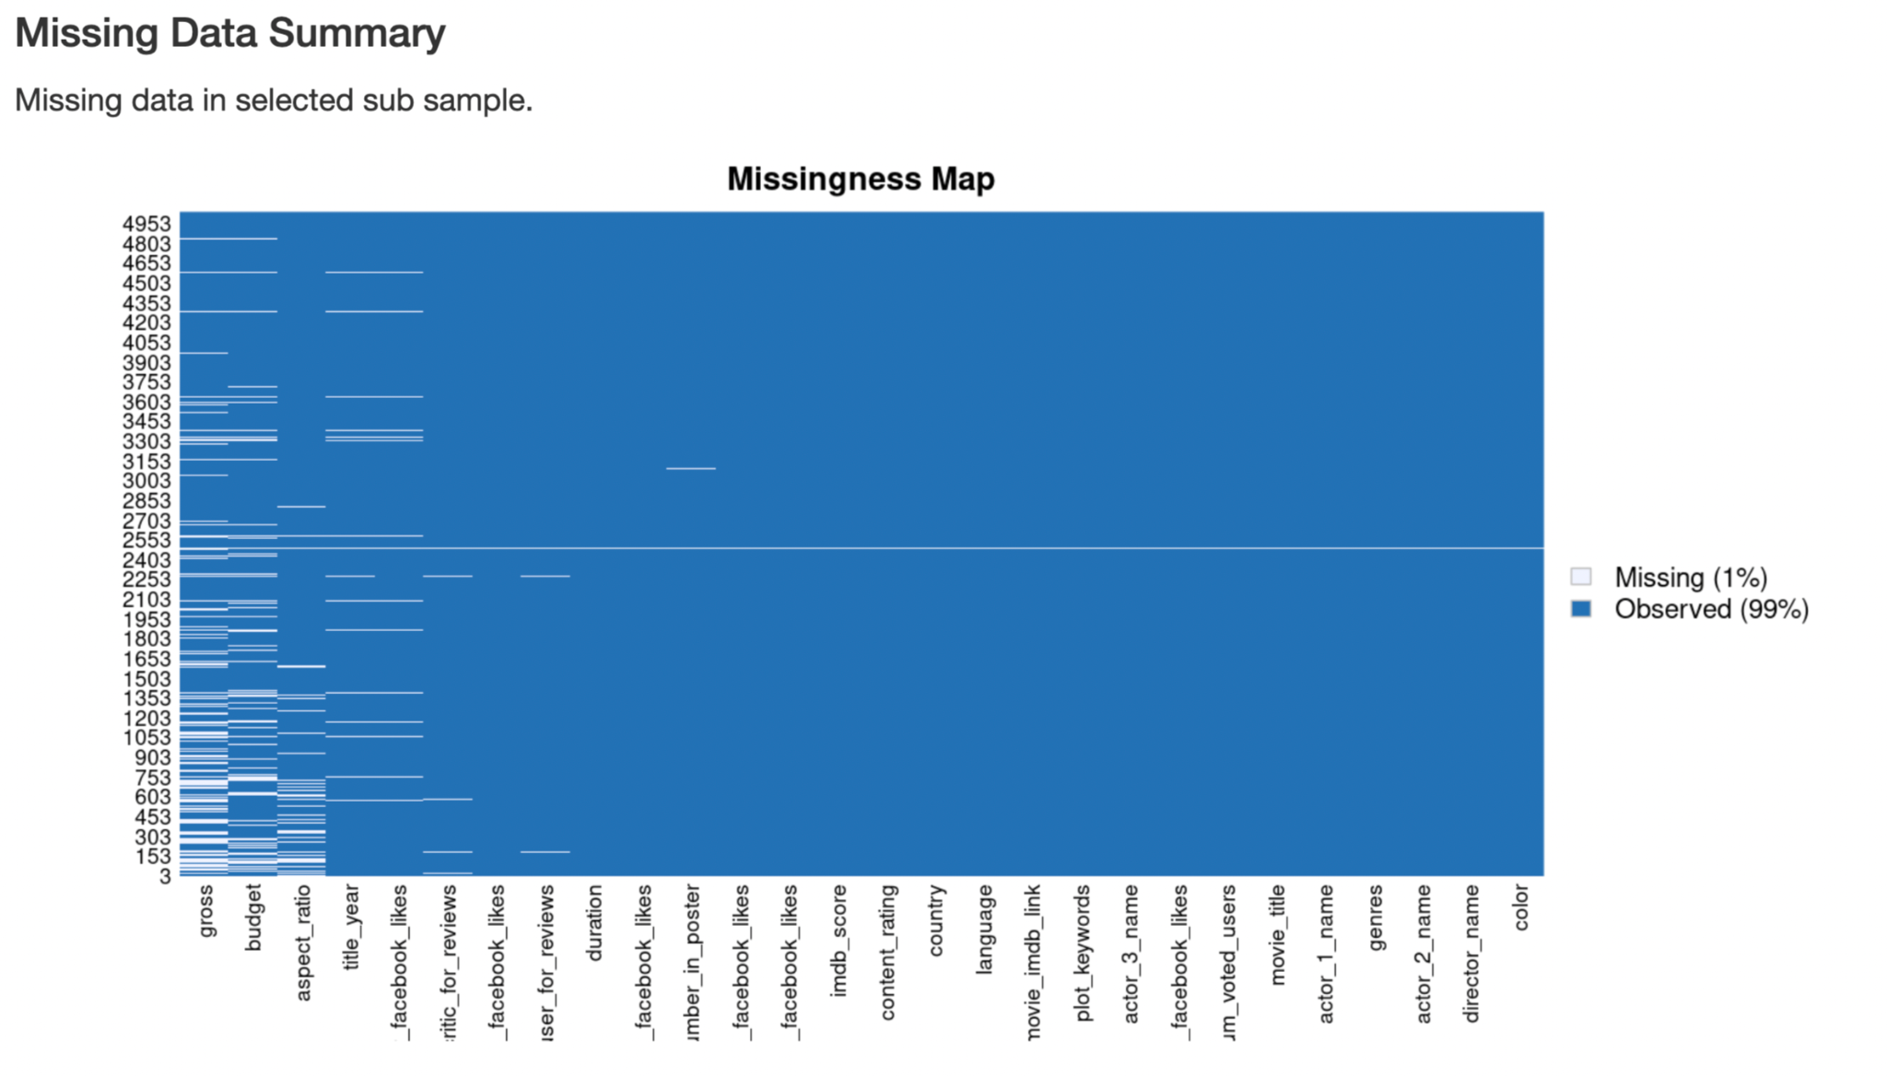

Slide 12
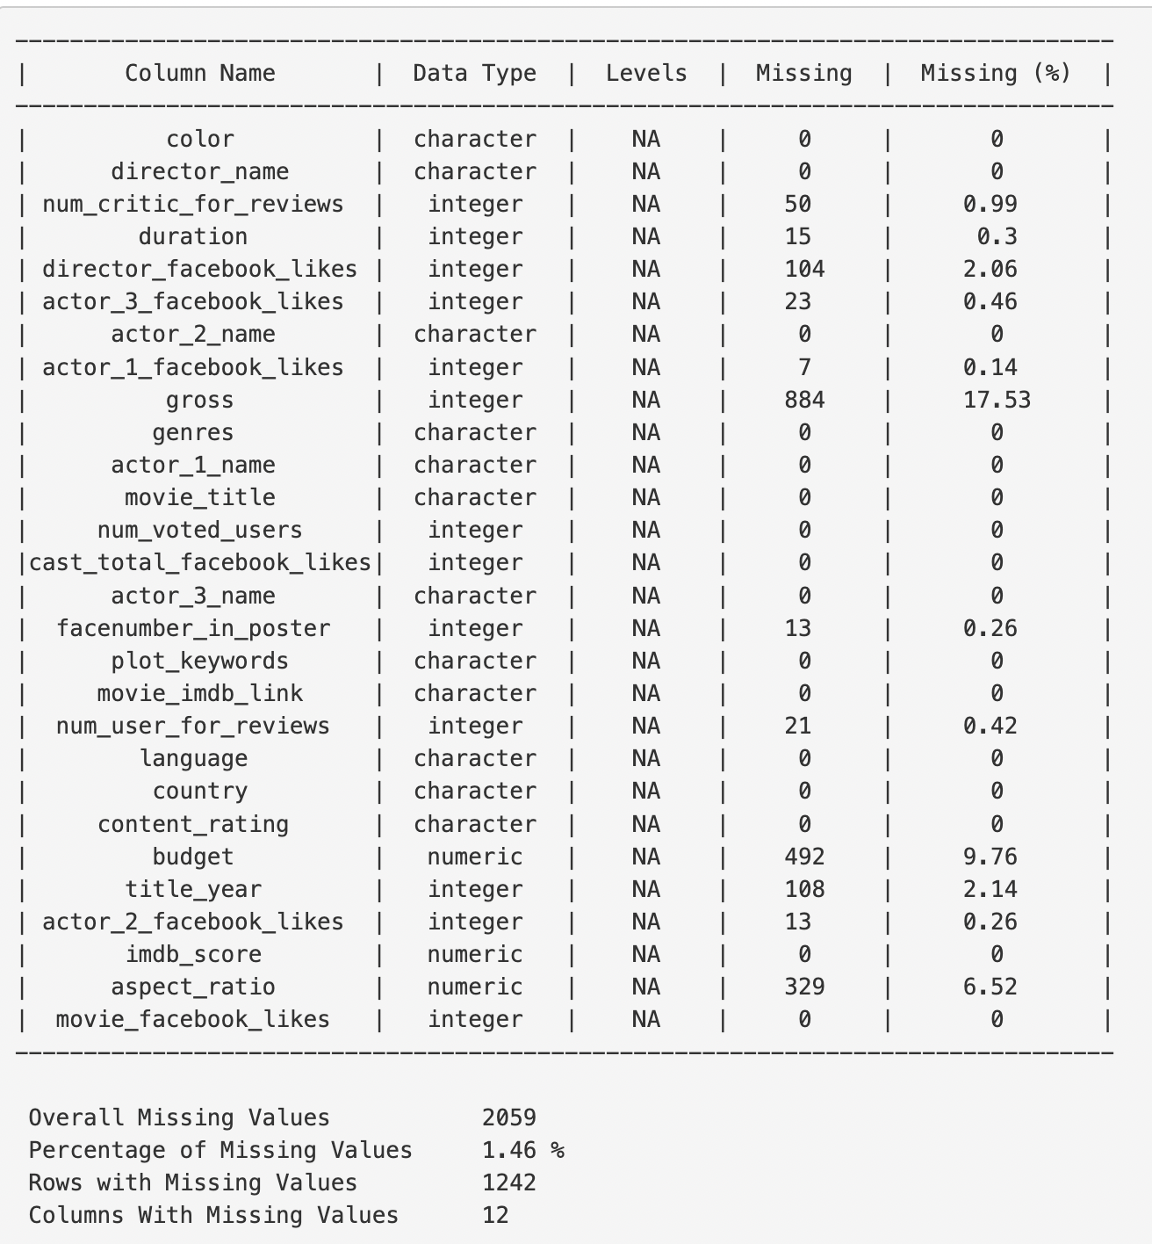
The summary of missing data

Slide 13
Main Variables missing data breakdown
IMDB score | 0 rows no data
Directors | 104 rows no data
Critic Reviews | 50 rows no data
Duration | 15 rows no data
Director Facebook likes | 104 rows no data
Actor Facebook like: | 7 rows no data
Genres | 0 rows no data
Gross Revenue | 884 rows no data
Budget | 482 rows no data
Plot Keywords | 153 rows no data

Slide 14
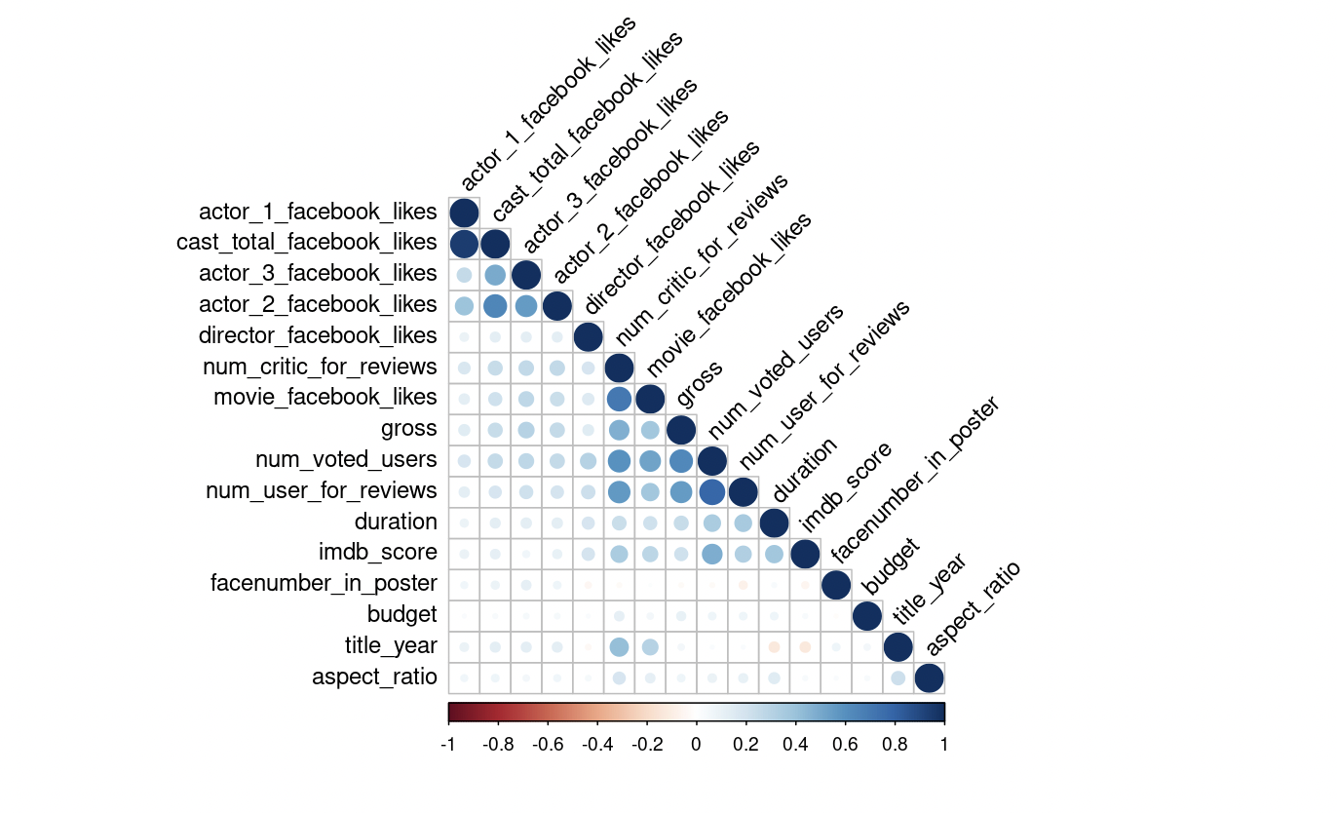
Data correlation plot
The Variables have some relationship with each others.
For example:
gross & num_voted_users
imdb score & actor facebook like
imdb score & num_user_for reviews
Notes:
do we need to delete missing data? No, You don’t know what observations you may or may not exclude
might be important or not

Slide 15
Data Visualization
01
Does IMDB score affect revenue?
02
Director’s effect on IMDB score
03
Lead Actors Effect on IMDB Score

Slide 16
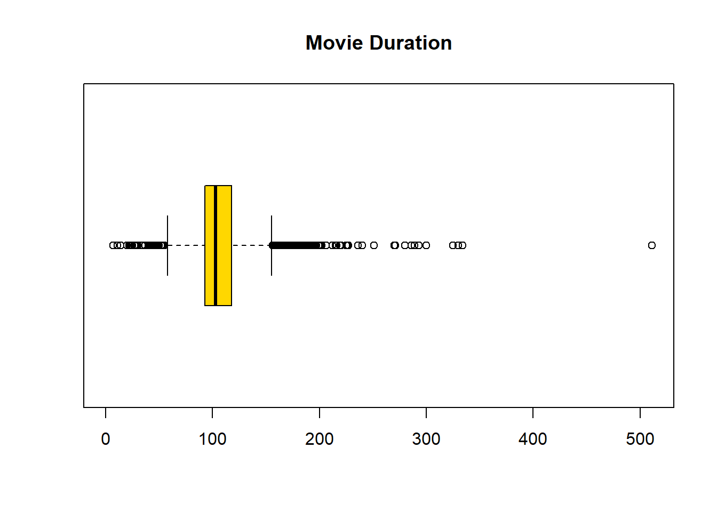
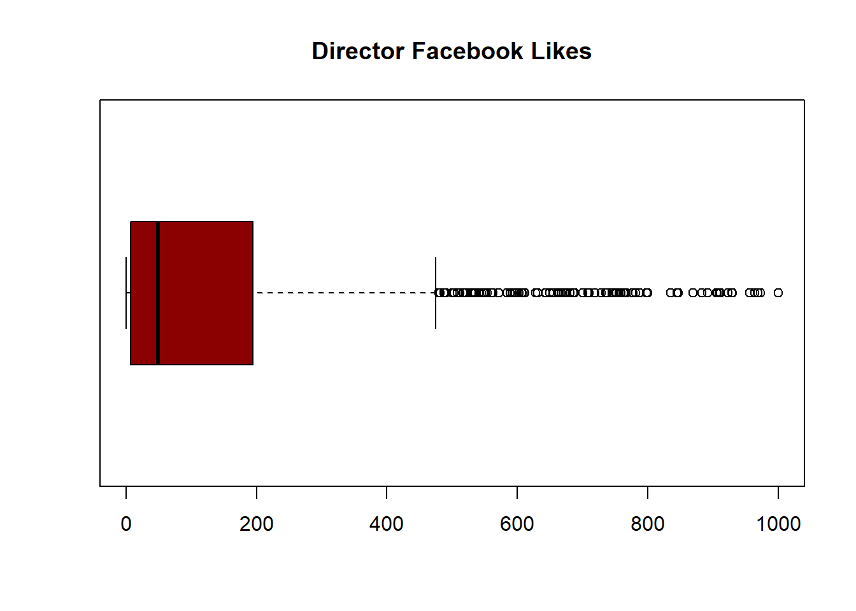
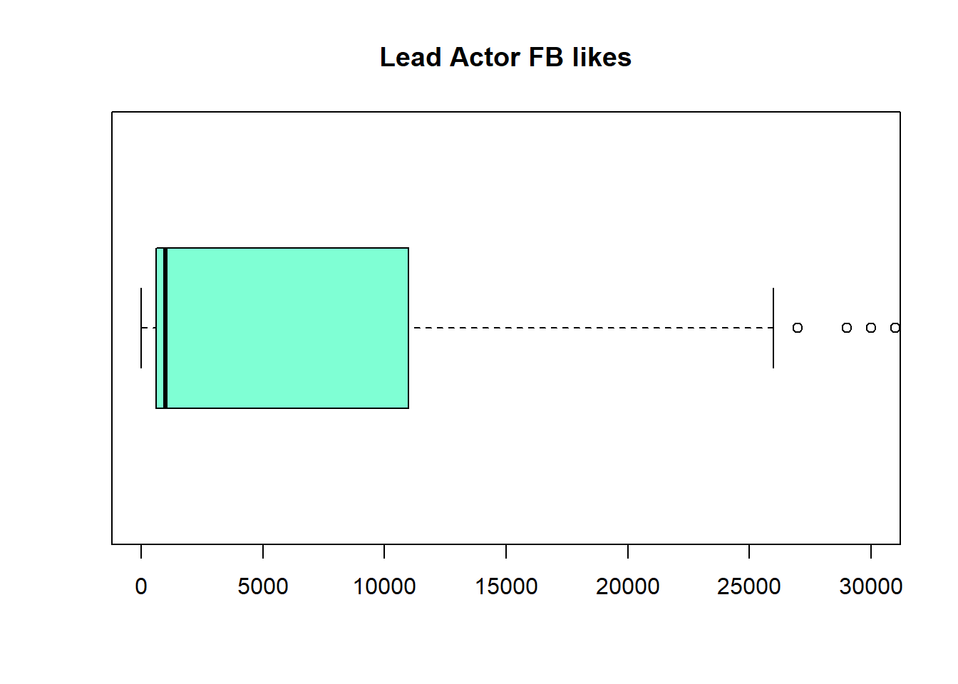
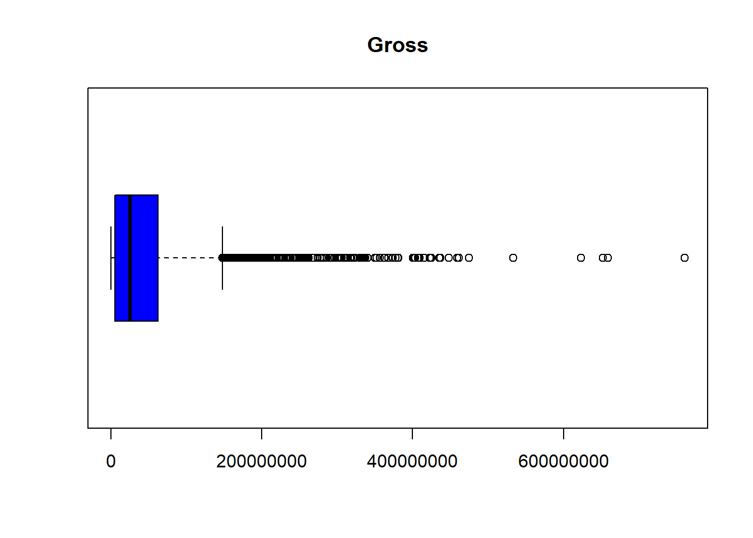
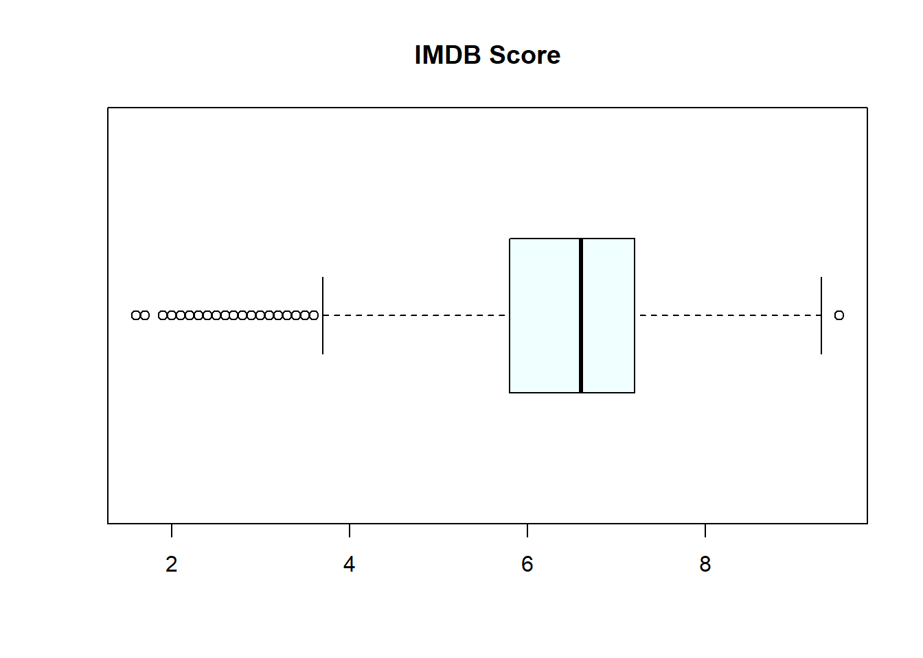
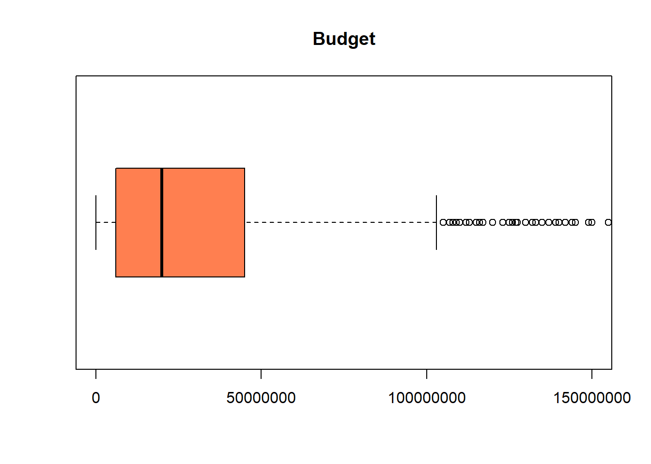
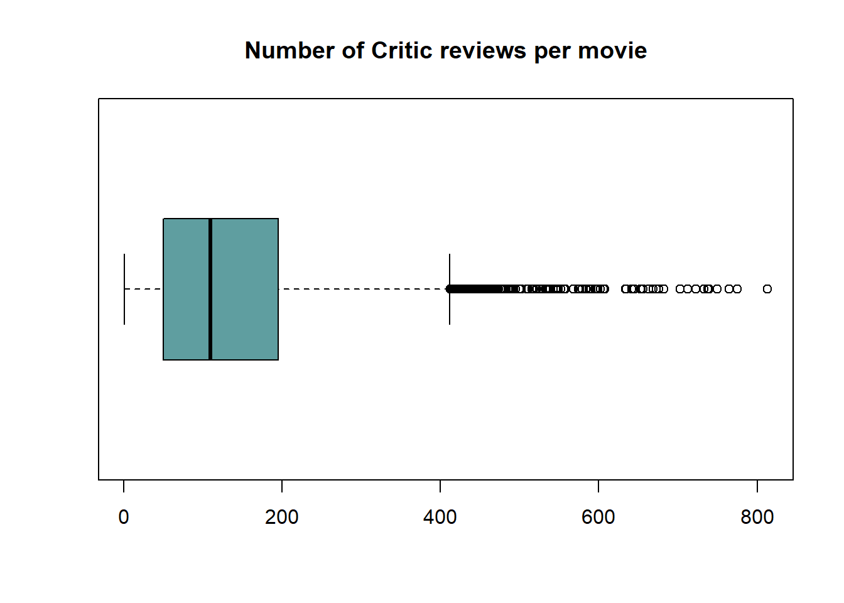
Data Exploration - Box and Whisker plots

Slide 17
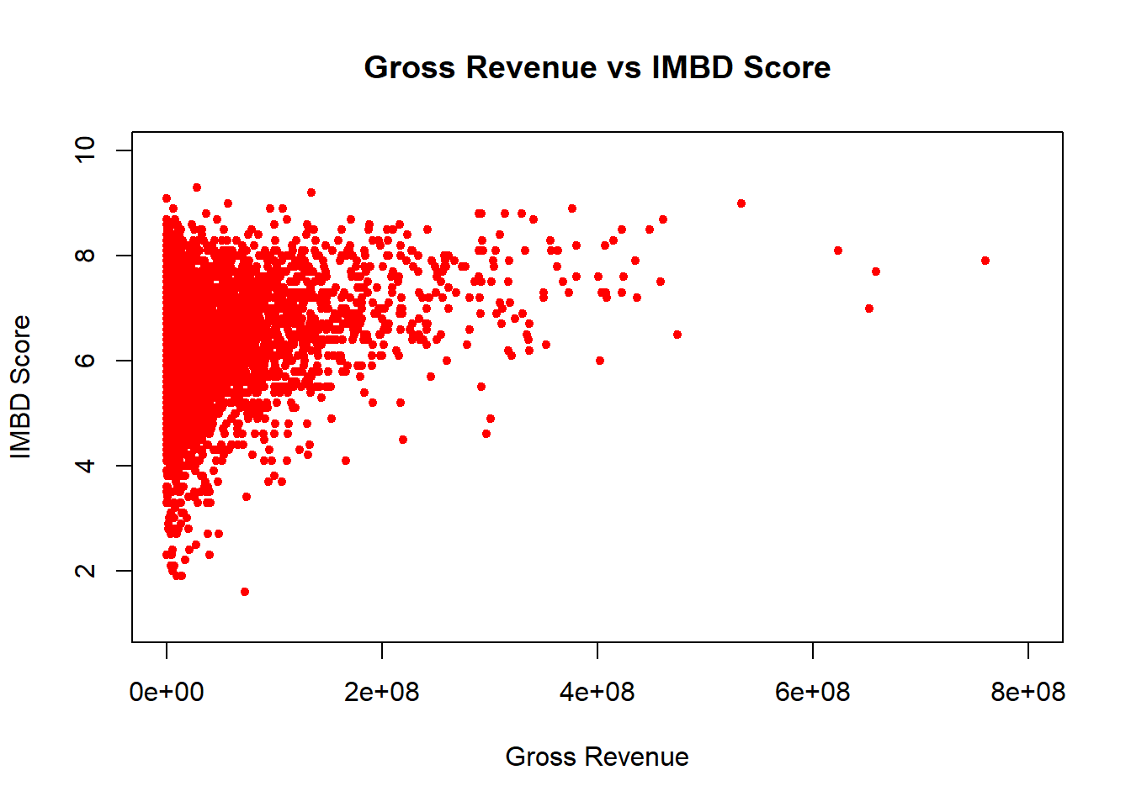
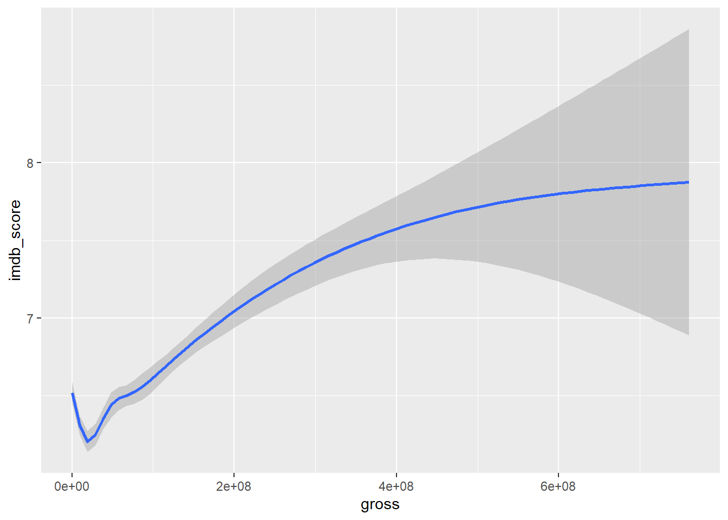
Q1 Does IMDB score affect revenue?
Left Skewed relationship
Suggests a relationship between the variables
Gross revenue is missing 17.53% of its data

Slide 18
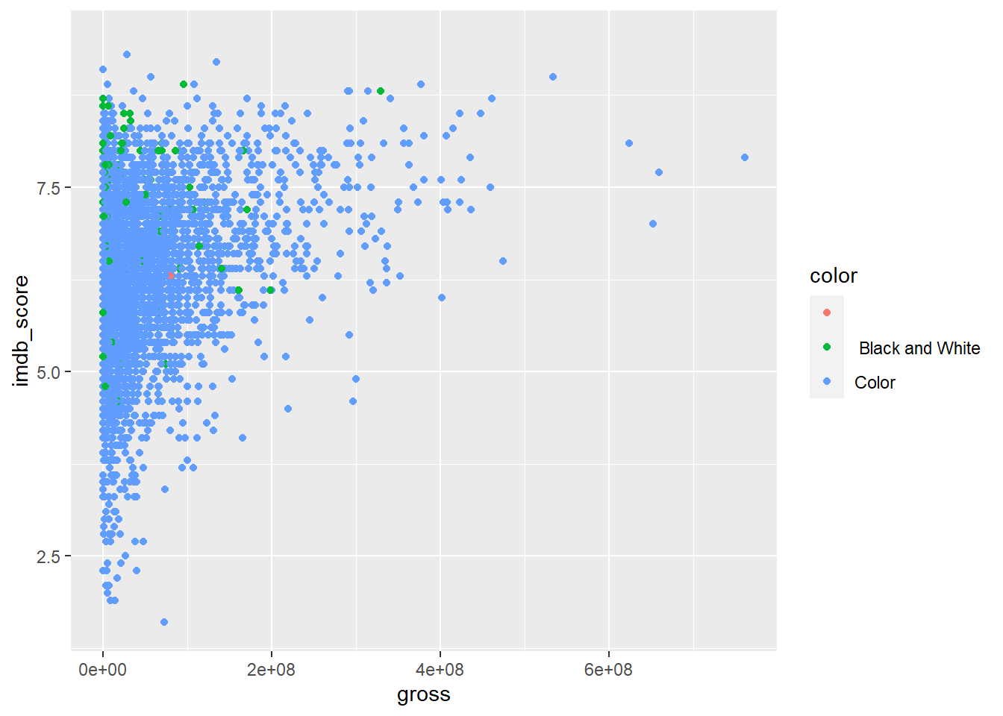
Q1 Does IMDB score affect revenue?
Gross and Imdb score with specification of Color vs Black and White movie

Slide 19
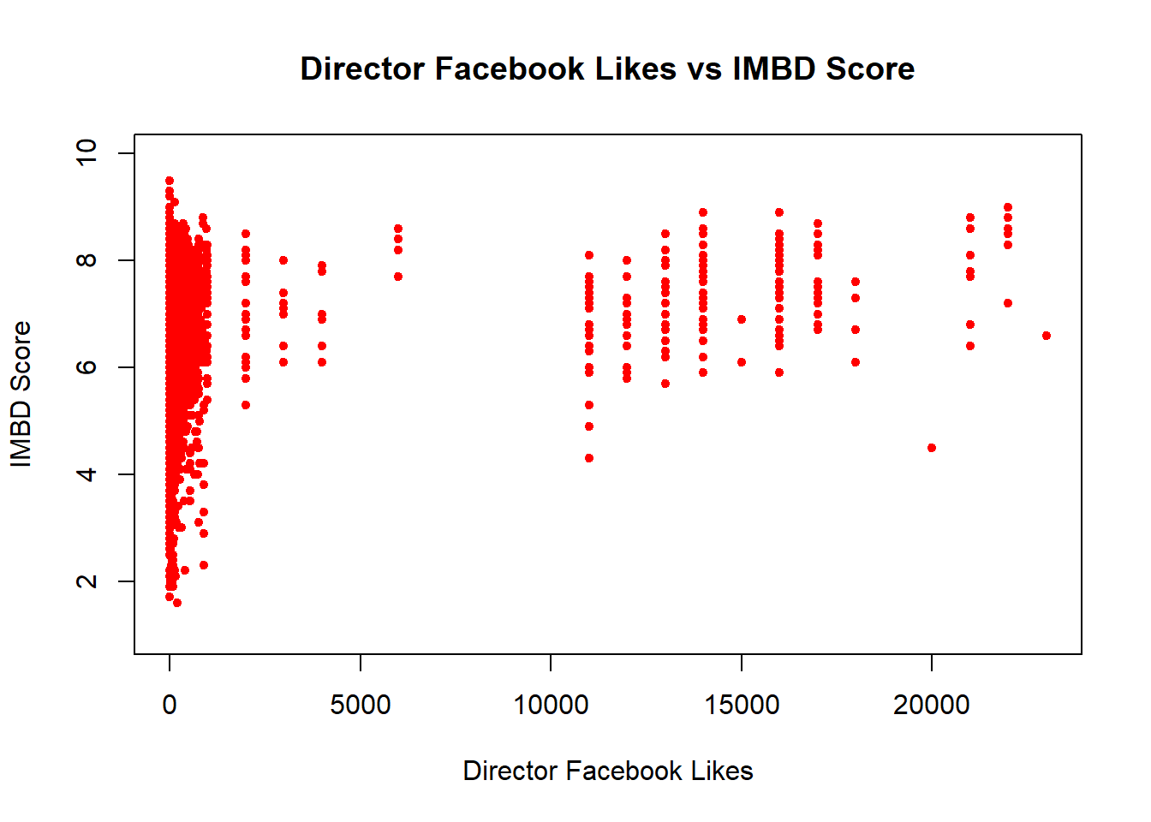
Q2 Director’s effect on IMDB score
Left Skewed Relationship
One director can have multiple data points, one per movie
Dead data if director has no social media account

Slide 20
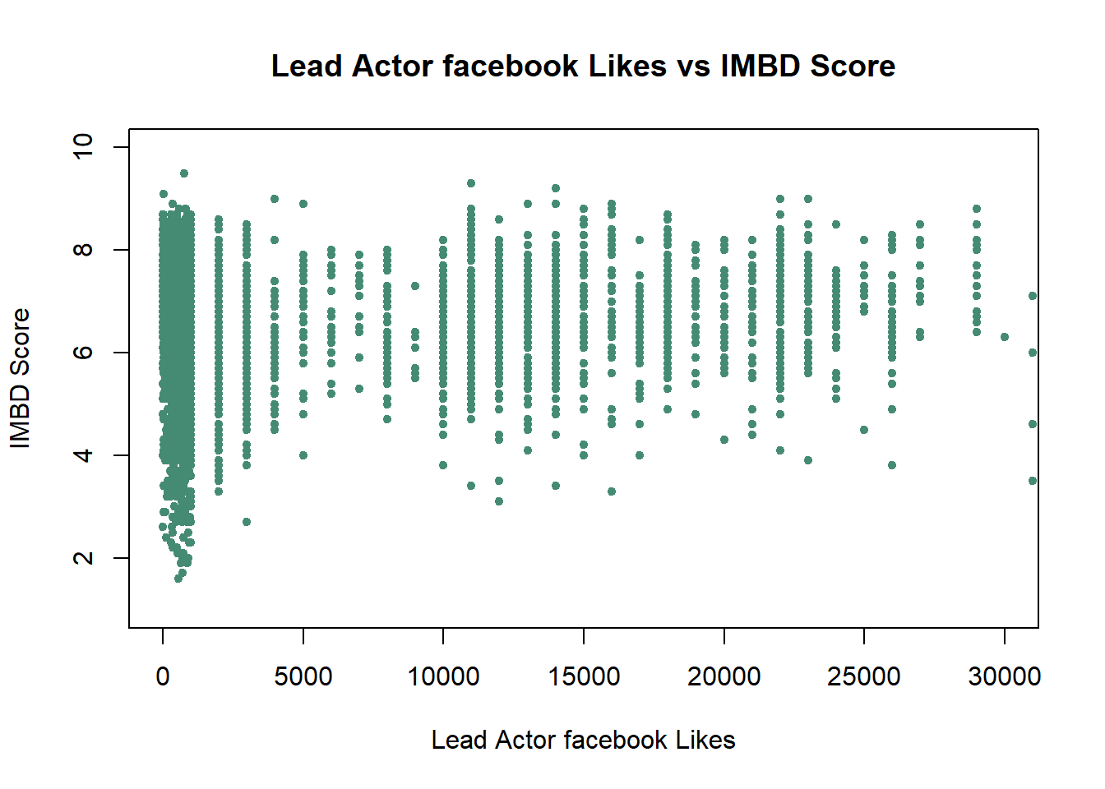
Q3 Lead Actors Effect on IMDB Score
Slightly Left Skewed Relationship
One actor can have multiple data points, one per movie
Dead data if Actor has no social media account

Slide 21
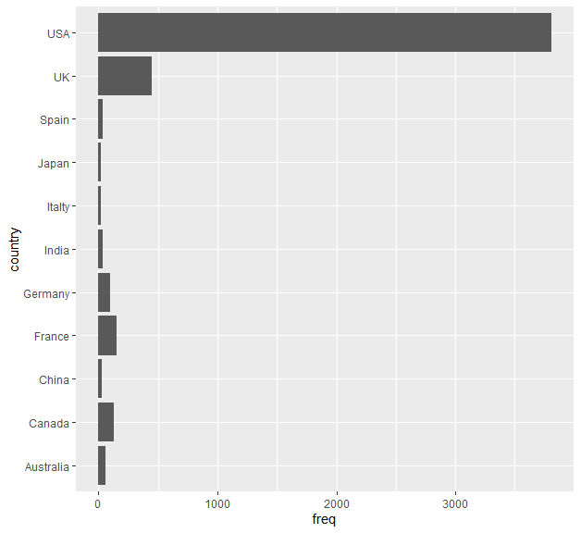
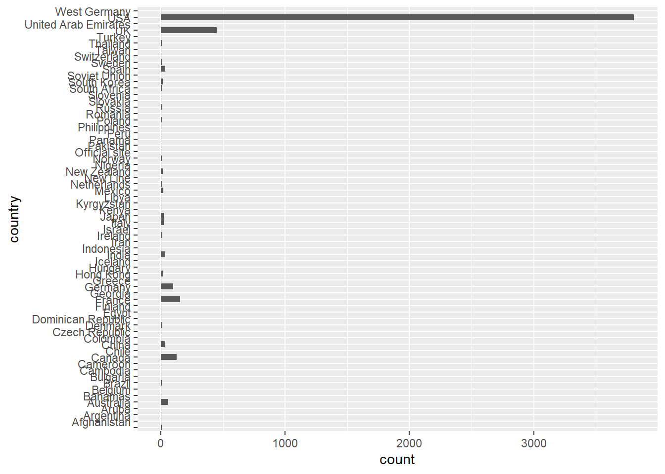
Q3 Lead Actors Effect on IMDB Score
Frequency of Movies from each country > 20 movies
Suggests our predictive model will be most applicable to the United States market
Country Graph all data

Slide 22
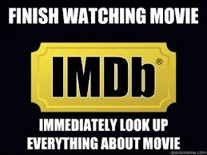


THANK YOU!
Welcome to ask questions!
Contact Us:
Adam Portillo <aport044@ucr.edu>
Suyash Saxena<ssaxe015@ucr.edu>
Chuyang Liu <cliu325@ucr.edu>
Jeewan Singh <jsing123@ucr.edu>
Minhua Jiang <mjian044@ucr.edu>

